Slide 1
Chapter 6: Process Synchronization

Slide 2
Chapter 6: Process Synchronization
Background
The Critical-Section Problem
Peterson’s Solution
Synchronization Hardware
Mutex Locks
Semaphores
Classic Problems of Synchronization
Monitors
Synchronization Examples

Slide 3
Objectives
Describe the critical-section problem and illustrate a race condition
Illustrate hardware solutions to the critical-section problem using memory barriers, compare-and-swap operations, and atomic variables
Demonstrate how mutex locks, semaphores, monitors, and condition variables can be used to solve the critical section problem
Evaluate tools that solve the critical-section problem in low-. Moderate-, and high-contention scenarios

Slide 4
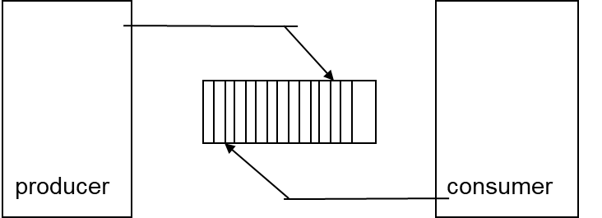
Background
Processes can execute concurrently
  May be interrupted at any time, partially completing execution
Concurrent access to shared data may result in data inconsistency
Maintaining data consistency requires mechanisms to ensure the orderly execution of cooperating processes

Slide 5
What’s the problem?
Suppose that we wanted to provide a solution to the consumer-producer problem that fills all the buffers.
We can do so by having a shared counter that keeps track of the number of full buffers.
Initially, counter is set to 0.
  It is incremented by the producer after it produces a new item into the buffer
  It is decremented by the consumer after it consumes an item from the buffer
If this is written in C++, what is the code to increment/decrement the counter?

Slide 6
Producer
while (true) {
/* produce an item in next produced */
while (counter == BUFFER_SIZE) ;
/* do nothing */
buffer[in] = next_produced;
in = (in + 1) % BUFFER_SIZE;
counter++;
}

Slide 7
Consumer
while (true) {
while (counter == 0)
; /* do nothing */
next_consumed = buffer[out];
out = (out + 1) % BUFFER_SIZE;
counter--;
/* consume the item in next consumed */
}

Slide 8
Race Condition
counter++ could be implemented as
register1 = counter
register1 = register1 + 1
counter = register1
counter-- could be implemented as
register2 = counter
register2 = register2 - 1
counter = register2
Consider this execution interleaving with “count = 5” initially:
  S0: producer execute register1 = counter {register1 = 5}
  S1: producer execute register1 = register1 + 1 {register1 = 6}
  S2: consumer execute register2 = counter {register2 = 5}
  S3: consumer execute register2 = register2 – 1 {register2 = 4}
  S4: producer execute counter = register1 {counter = 6 }
  S5: consumer execute counter = register2 {counter = 4}
  When several processes/threads access and manipulate the same data concurrently and the outcome of the execution depends on the particular order in which the access takes place is called race condition.

Slide 9
Critical Section
Any code segment that manipulates a shared variable should be part of a critical section.
In the producer-consumer example, counter should be incremented/decremented in a critical section.
A critical section is a section that must be synchronized for multiple processes or threads because lack of synchronization can result in errors.
The simplest case is shared variables, but other shared resources need to be synchronized as well. Often the code to allocate / return the resource is part of a critical section.

Slide 10
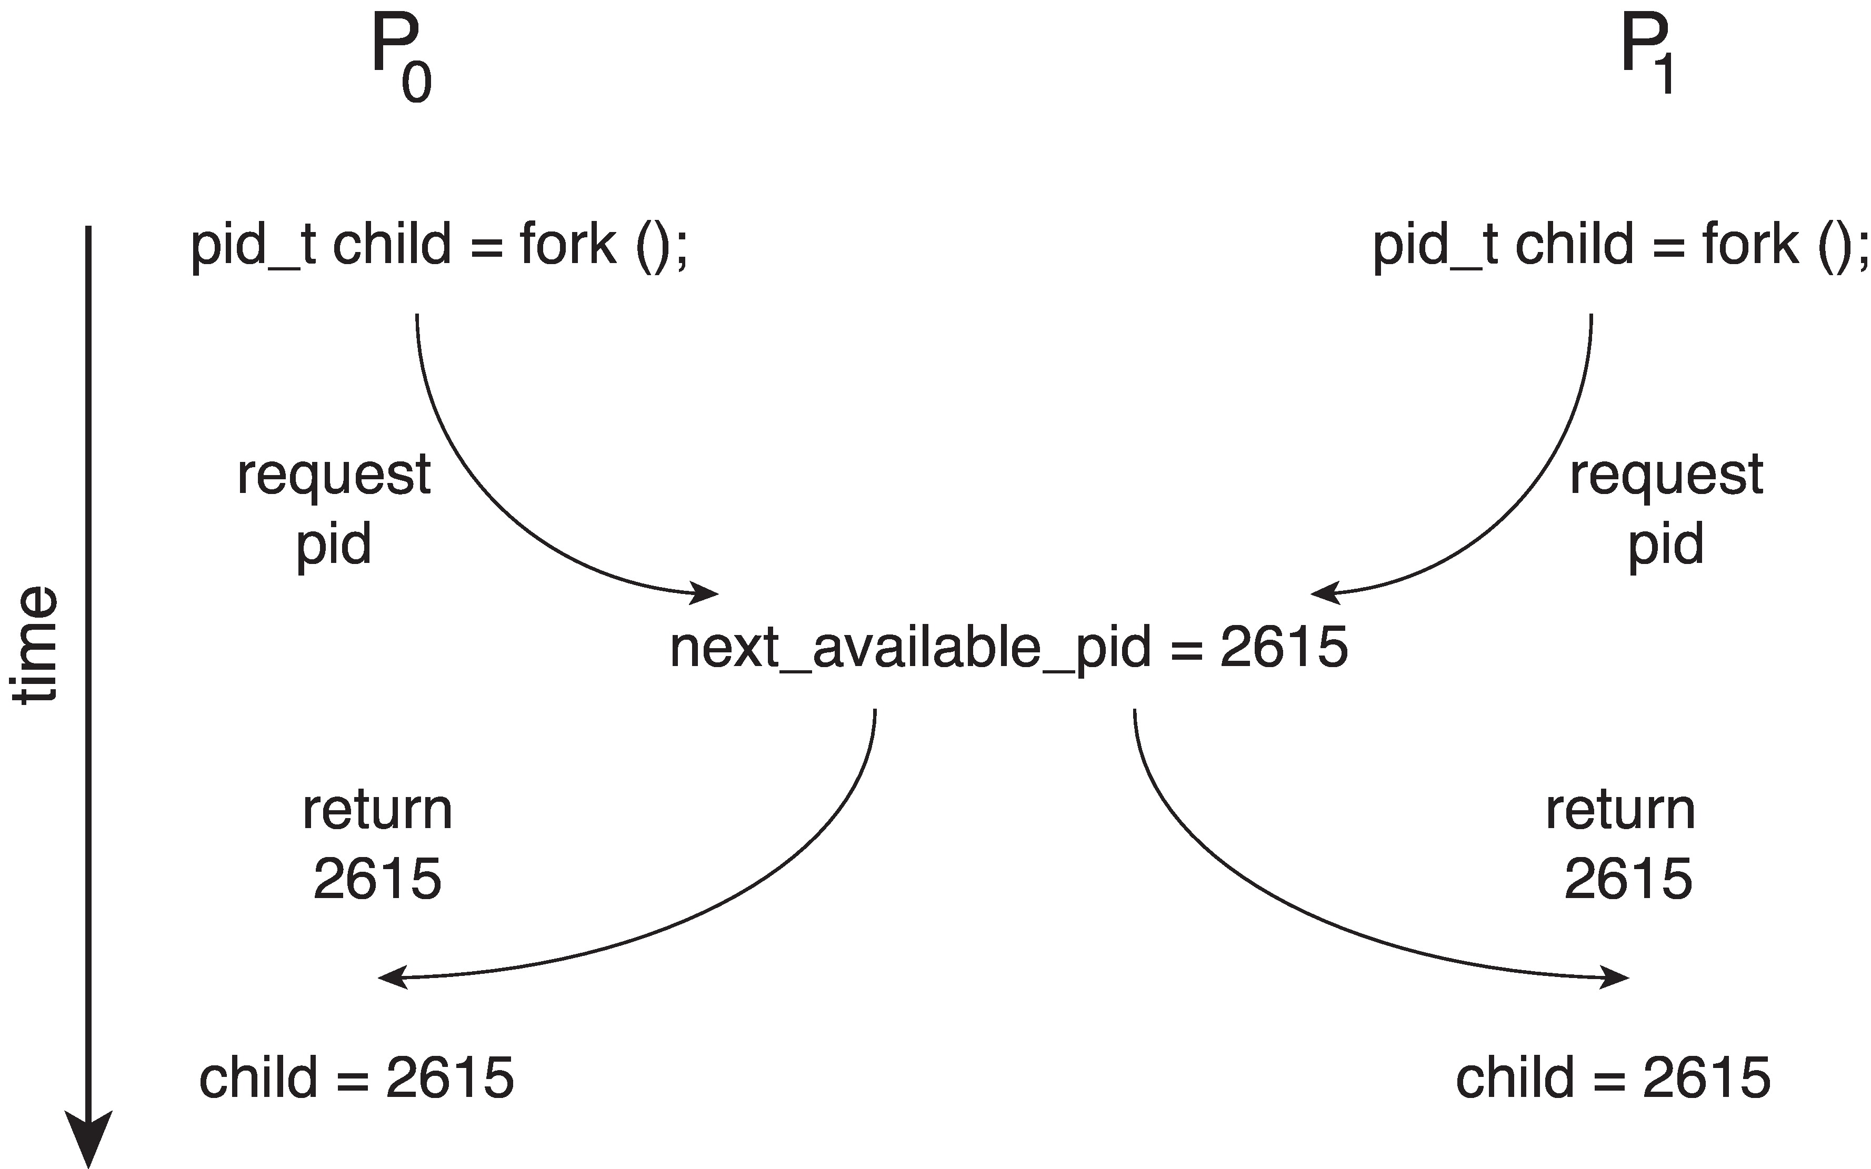
Race Condition
Processes P₀ and P₁ are creating child processs using the fork() system call
Race condition on kernel variable next_available_pid which represents the next available process identifier (pid)
Unless there is mutual exclusion, the same pid could be assigned to two different processes!
These issues led us to concentrate on process synchronization and cooperation.

Slide 11
Critical Section Problem
Consider system of n processes {p₀, p₁, … p_{n-1}}
Each process has critical section segment of code
  Process may be changing common variables, updating table, writing file, etc
  When one process in critical section, no other may be in its critical section
Critical section problem is to design protocol to solve this
Each process must ask permission to enter critical section in entry section, may follow critical section with exit section, then remainder section

Slide 12

Critical Section
General structure of process P_{i}

Slide 13
Solution to Critical-Section Problem
1. Mutual Exclusion - If process P_{i} is executing in its critical section, then no other processes can be executing in their critical sections
2. Progress - If no process is executing in its critical section and there exist some processes that wish to enter their critical section, then only those processes that are not in their remainder sections can participate in deciding which will enter the critical section next, and this selection of the processes that will enter the critical section next cannot be postponed indefinitely
3. Bounded Waiting - A bound must exist on the number of times that other processes are allowed to enter their critical sections after a process has made a request to enter its critical section and before that request is granted
  Assume that each process executes at a nonzero speed
  No assumption concerning relative speed of the n processes

Slide 14
Solution Synonyms
Mutual Exclusion
  Mutual Exclusion guarantees that results are correct and not corrupted. Each process has access to the critical region and is the only process that has access at that time
Deadlock happens when one or more processes can’t make progress.
  Deadlock generally involves two or more processes competing for the same resources where P_{i} has R_{i} but needs R_{j} and P_{j} has R_{j} but needs R_{i.}
  Deadlock avoidance guarantees that every process makes progress and there is no process stuck waiting on a resource held by another process that is also waiting on a resource it can’t get.
Starvation is when a process never gets a chance to run. Waiting is unbounded.
  Usually, starvation is the result of policy such as priority scheduling.
  As long as every process gets a chance to run, starvation is avoided.

Slide 15
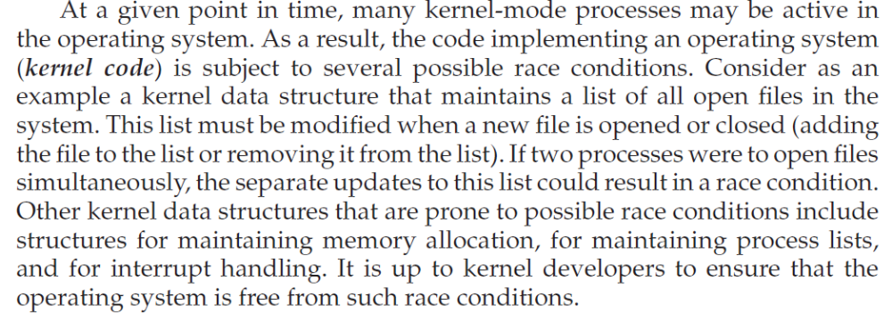
Kernel-mode processes

Slide 16
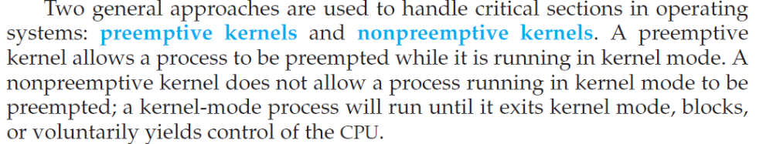
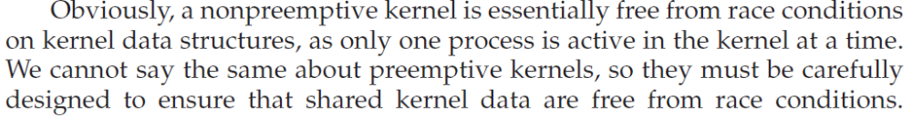
Preemptive and non-preemptive kernels

Slide 17
Critical-Section Handling in OS
Two approaches depending on if kernel is preemptive or non- preemptive
  Preemptive – allows preemption of process when running in kernel mode. ⬅ Hard one!!
  Non-preemptive – runs until exits kernel mode, blocks, or voluntarily yields CPU
    Essentially free of race conditions in kernel mode

Slide 18
Algorithm for Process P_{i}
do {
while (turn == j);
critical section
turn = j;
remainder section
} while (true);
Reasons for failure:
Ensures Mutual Exclusion and bounded waiting (P0 and P1 alternate access).
If P0 takes an unduly long time in it’s remainder section, P1 never gets into the critical section there Progress is not made for P1.

Slide 19
Algorithm for Process P_{i}
do {
flag[j] = TRUE;
while (flag[i]);
critical section
flag[j] = FALSE;
remainder section
} while (true);
Reasons for failure:
Satisfies Mutual Exclusion but not bounded waiting or progress.

Slide 20
Algorithm for Process P_{i}
do {
while (flag[i]);
flag[j] = TRUE;
critical section
flag[j] = FALSE;
remainder section
} while (true);
Reasons for failure:
Satisfies progress but not bounded waiting. Can deadlock.

Slide 21
Peterson’s Solution for CS Problem
Good algorithmic description of solving the problem
Two process solution
Assume that the load and store machine-language instructions are atomic; that is, cannot be interrupted
The two processes share two variables:
  int turn;
  Boolean flag[2]
The variable turn indicates whose turn it is to enter the critical section
The flag array is used to indicate if a process is ready to enter the critical section. flag[i] = true implies that process P_{i} is ready!
NEED BOTH THE turn and flag[2] to guarantee Mutual Exclusion, Bounded waiting, Progress.
Initially flag[0] and flag[1]=false

Slide 22
Peterson’s Algorithm
Process P_{i}
Process P_{j}
do {
flag[i] = true; // intent
turn = j; // giving away
while (flag[j] && turn==j)
; // wait for either
critical section
flag[i] = false;
remainder section
} while (true);
do {
flag[j] = true;
turn = i;
while (flag[i] && turn==i)
;
critical section
flag[j] = false;
remainder section
} while (true);

Slide 23
Algorithm for Process P_{i}
do {
flag[i] = true; // i is ready
turn = j; // Give P_{j} a chance first
while (flag[j] && turn == j);
critical section
flag[i] = false;
remainder section
} while (true);
Peterson’s says, Pi is ready to enter critical section. Let Pj go first.
If Pj is waiting, then flag[i] == true but turn != i because turn was just set to j.. therefore, Pj proceeds out of loop to critical section and Pi is in the loop.
if Pj is not waiting, then flag[j] == false, so Pi can proceed into the critical section.
if Pj is in the critical section, then Pi waits because flag[j] == true (Pj set it) and turn == j (Pi set it). When Pj is done, flag[j] == false, so Pi can proceed.

Slide 24
Peterson’s Solution
Here, mutual exclusion, progress and bounded waiting are all satisfied.
But this solution works for only two processes.
Although useful for demonstrating an algorithm, Peterson’s Solution is not guaranteed to work on modern architectures with multiple cores.

Slide 25
Synchronization Hardware
Many systems provide hardware support for implementing the critical section code.
All solutions mostly based on idea of locking
  Protecting critical regions via locks
do {
acquire lock
critical section
release lock
remainder section
} while (TRUE);
Uniprocessors – could disable interrupts
  Currently running code would execute without preemption
  Generally too inefficient on multiprocessor systems
    Time consuming, since message must be passed to all processors that delays entry to critical section.

Slide 26
Hardware Instructions
Modern machines provide special atomic hardware instructions
    Atomic = non-interruptible
Special hardware instructions that allow us to either test-and-modify the content of a word, or two swap the contents of two words atomically (uninterruptedly.)
Test-and-Set instruction
Swap instruction

Slide 27
1. test_and_set Instruction
Definition:
boolean test_and_set (boolean *target)
{
boolean rv = *target;
*target = TRUE;
return rv:
}
Executed atomically
Returns the original value of passed parameter
Set the new value of passed parameter to “TRUE”.
When target == FALSE, target is set to TRUE but FALSE is returned, so loop is exited.
When target == TRUE, target is set to TRUE, but TRUE is returned, so continue to loop.

Slide 28
Solution using test_and_set()
Shared Boolean variable lock, initialized to FALSE
Solution:
do {
while (test_and_set(&lock))
; /* do nothing */
/* critical section */
lock = false;
/* remainder section */
} while (true);
Think of test_and_set as an atomic version of i++ except it can only ever be 0 or 1. When leaving the critical section, lock is reset.

Slide 29
Test and Set Instruction
Mutual exclusion is preserved:
if Pi enters the CS, the other Pj are busy waiting
• Problem: still using busy waiting
• When Pi exits CS, the selection of the Pj who will enter CS is arbitrary: no bounded waiting. Hence starvation is possible

Slide 30
2. Swap Instruction
Definition:
void Swap(boolean &a, boolean &b) {
boolean temp = a;
a = b;
b = temp;
}
Executed atomically

Slide 31
Solution using Swap
Shared Boolean variable lock, initialized to FALSE
Solution:
do {
key = true;
while (key == true)
Swap(lock,key);
critical section
lock = false;
remainder section
}

Slide 32
3. Bounded-waiting Mutual Exclusion with test_and_set
boolean waiting[n];
boolean lock; //INITIALLY FALSE
do {
waiting[i] = true; // i wants to enter CS
key = true; // assume we are locked out
while (waiting[i] && key) // busy wait for lock
key = test_and_set(&lock);
waiting[i] = false; // i no longer waiting, in CS
/* critical section */
j = (i + 1) % n; // select next process j
while ((j != i) && !waiting[j])
j = (j + 1) % n; // does this j want to be next
if (j == i) // no other process waiting
lock = false; // unlock
else // otherwise, give j the lock
waiting[j] = false; // let j in CS
/* remainder section */
} while (true);
Entry
Exit

Slide 33
Machine Instruction Solution
Advantages
  Applicable to any number of processes on either a single processor or multiple processors sharing main memory
  Simple and easy to verify
  It can be used to support multiple critical sections; each critical section can be defined by its own variable
Disadvantages
  Busy-waiting is employed, thus while a process is waiting for access to a critical section it continues to consume processor time
  Starvation is possible when a process leaves a critical section and more than one process is waiting
  Deadlock is possible if a low priority process has the critical region and a higher priority process needs, the higher priority process will obtain the processor to wait for the critical region

Slide 34
Mutex Locks
Previous solutions are complicated and generally inaccessible to application programmers
OS designers build software tools to solve critical section problem – OS ensures it is atomic.
Simplest is mutex lock – MUTUAL EXCLUSION LOCK
  Boolean variable indicating if critical section is available or not
Protect a critical section by first acquire() a lock then release() the lock
Calls to acquire() and release() must be atomic
  Usually implemented via hardware atomic instructions
But this solution requires busy waiting
  This lock therefore called a spinlock

Slide 35
acquire() and release()
acquire() {
while (!available)
; /* busy wait */
available = false;;
}
release() {
available = true;
}
do {
acquire lock
critical section
release lock
remainder section
} while (true);

Slide 36
Semaphore
Synchronization tool that provides more sophisticated ways (than Mutex locks) for process to synchronize their activities.
Semaphore S – integer variable
Apart from initialization the semaphore can only be accessed via two indivisible (atomic) operations
  wait() and signal() or sem_wait() and sem_post()
    Originally called P() and V()
Definition of the wait() operation
  wait(S) {
  while (S <= 0) // 0 means first waiting, <0 means queue
  ; // busy wait
  S--;
  }
Definition of the signal() operation
  signal(S) {
  S++;
  }

Slide 37
Semaphore Usage – Binary Semaphore
Binary semaphore – integer value can range only between 0 and 1
Same as a mutex lock, provide mutual exclusion and can be used to deal with critical section problem for multiple processes for a single resource.
The ‘n’ processes share a semaphore mutex initialized to1.
Each process P_{i} organized as shown.
        do
        {
        wait(mutex);
        //critical section
        signal(mutex);
        //remainder section
        }while(TRUE);

Slide 38
Semaphore Usage – Counting semaphore
Counting semaphore – integer value can range over an unrestricted domain
Counting semaphores can be used to control access to a given resource consisting of a finite number of instances.
This semaphore is initialized to the number of resources available.
Each process that wishes to use a resource performs a wait() operation on the semaphore thereby decrementing the count.
When the count for semaphore goes to 0, all resources are being used.
After that processes that wish to use a resource will block until the count becomes greater than 0.

Slide 39
Semaphore Usage
Can solve various synchronization problems
Consider P₁ and P₂ that require S₁ to happen before S₂
Create a semaphore “synch” initialized to 0
  P1:
  S₁;
  signal(synch);
  P2:
  wait(synch);
  S₂;
Can implement a counting semaphore S as a binary semaphore
If P1 gets there first, no problem.
If P2 gets there first, wait for synch.
Process P2 will busy wait for P1.

Slide 40
Semaphore Implementation
Must guarantee that no two processes can execute the wait() and signal() on the same semaphore at the same time
Thus, the implementation becomes the critical section problem where the wait and signal code are placed in the critical section
  Could now have busy waiting in critical section implementation
    But implementation code is short
    Little busy waiting if critical section rarely occupied
Note that applications may spend lots of time in critical sections and therefore this is not a good solution

Slide 41
Semaphore Implementation with no Busy waiting
With each semaphore there is an associated waiting queue
Each entry in a waiting queue has two data items:
  value (of type integer)
  pointer to next record in the list
Two operations:
  block – place the process invoking the operation on the appropriate waiting queue
  wakeup – remove one of processes in the waiting queue and place it in the ready queue
typedef struct{
int value;
struct process *list;
} semaphore;

Slide 42
Implementation with no Busy waiting (Cont.)
wait(semaphore *S) {
S->value--;
if (S->value < 0) { // Process has to wait
add this process to S->list;
block();
}
}
signal(semaphore *S) {
S->value++;
if (S->value <= 0) { // Processes are waiting
remove a process P from S->list;
wakeup(P);
}
}

Slide 43
Deadlock and Starvation
Deadlock – two or more processes are waiting indefinitely for an event that can be caused by only one of the waiting processes
Let S and Q be two semaphores initialized to 1
P₀ P₁
wait(S); wait(Q);
wait(Q); wait(S);
... ...
signal(S); signal(Q);
signal(Q); signal(S);
Starvation – indefinite blocking
  A process may never be removed from the semaphore queue in which it is suspended

Slide 44
Priority Inversion
Priority Inversion – Scheduling problem when lower-priority process holds a lock needed by higher-priority process
  Assume that 3 processes L, M and H with priority order L<M<H arrives for execution in order L, M and H with some time interval between them.
  L uses Resource R1 - So R1 locked
  H arrives, L is preempted and H executes
  Now, H needs Resource R1 - But R1 locked so H goes for waiting and L continues.
  Now M comes for execution. L preempted since H has high priority than L, so waiting time of H increased. This is priority inversion problem.
Solved via priority-inheritance protocol
  All processes that are accessing resources needed by higher priority process inherit higher priority until they are finished using the resource, then priority restored.

Slide 45
Classical Problems of Synchronization`
Classical problems used to test newly-proposed synchronization schemes
  Bounded-Buffer Problem
  Readers and Writers Problem
  Dining-Philosophers Problem

Slide 46
Bounded-Buffer Problem
n buffers, each can hold one item
Semaphore mutex initialized to the value 1
Semaphore full initialized to the value 0
Semaphore empty initialized to the value n

Slide 47
Bounded Buffer Problem (Cont.)
The structure of the producer process
do {
...
/* produce an item in next_produced, see slide 6 */
...
wait(empty);
wait(mutex);
...
/* add next produced to the buffer */
...
signal(mutex);
signal(full);
} while (true);

Slide 48
Bounded Buffer Problem (Cont.)
The structure of the consumer process
Do {
wait(full);
wait(mutex);
...
/* remove an item from buffer to next_consumed */
/* see slide 7 */
...
signal(mutex);
signal(empty);
...
/* consume the item in next consumed */
...
} while (true);

Slide 49
Readers-Writers Problem
A data set is shared among a number of concurrent processes
  Readers – only read the data set; they do not perform any updates
  Writers – can both read and write
Problem – allow multiple readers to read at the same time
  Only one single writer can access the shared data at the same time
Several variations of how readers and writers are considered – all involve some form of priorities
Shared Data
  Data set
  Semaphore rw_mutex initialized to 1 controls access to write.
  Semaphore mutex initialized to 1 controls access to read_count
  Integer read_count initialized to 0, keeps track of readers.

Slide 50
Readers-Writers Problem (Cont.)
The structure of a writer process
do {
wait(rw_mutex);
...
/* writing is performed */
...
signal(rw_mutex);
} while (true);

Slide 51
Readers-Writers Problem (Cont.)
The structure of a reader process
do {
wait(mutex); // Only 1 can access read_count
read_count++;
if (read_count == 1)
wait(rw_mutex);// First reader blocks writer.
signal(mutex);
...
/* reading is performed */
...
wait(mutex);
read count--;
if (read_count == 0)
signal(rw_mutex);// No reader, unblock writer
signal(mutex);
} while (true);

Slide 52
Readers-Writers Problem Variations
First variation – no reader kept waiting unless writer has permission to use shared object
Second variation – once writer is ready, it performs the write ASAP
Both may have starvation leading to even more variations
Problem is solved on some systems by kernel providing reader-writer locks

Slide 53
2nd Reader-Writers, Writers Priority
do { // Reader process, extra mutex
wait(read_mutex);
wait(mutex); // Only 1 can access read_count
read_count++;
if (read_count == 1)
wait(rw_mutex);// First reader blocks writer.
signal(mutex);
signal(read_mutex);
...
/* reading is performed */
...
wait(mutex);
read count--;
if (read_count == 0)
signal(rw_mutex);// No reader, unblock writer
signal(mutex);
} while (true);

Slide 54
do { // Writer process similar to reader, also uses extra mutex
wait(mutex); // Only 1 can access write_count
write_count++;
if (write_count == 1)
wait(read_mutex);// First writer blocks readers.
signal(mutex);
wait(rw_mutex); // A writer has access
...
/* writing is performed */
...
signal(rw_mutex);
wait(mutex);
write_count--;
if (write_count == 0)
signal(read_mutex);// No writer, unblock writer
signal(mutex);
} while (true);

Slide 55

Dining-Philosophers Problem
Philosophers spend their lives alternating thinking and eating
Don’t interact with their neighbors, occasionally try to pick up 2 chopsticks (one at a time) to eat from bowl
  Need both to eat, then release both when done
In the case of 5 philosophers
  Shared data
    Bowl of rice (data set)
    Semaphore chopstick [5] initialized to 1

Slide 56
Dining-Philosophers Problem Algorithm
The structure of Philosopher i:
    do {
    wait (chopstick[i] );
    wait (chopStick[ (i + 1) % 5] );
    // eat
    signal (chopstick[i] );
    signal (chopstick[ (i + 1) % 5] );
    // think
    } while (TRUE);
What is the problem with this algorithm? Deadlock

Slide 57
Dining-Philosophers Problem Algorithm (Cont.)
Deadlock handling
  Allow at most 4 philosophers to be sitting simultaneously at the table.
  Allow a philosopher to pick up the forks only if both are available (picking must be done in a critical section.
  Use an asymmetric solution -- an odd-numbered philosopher picks up first the left chopstick and then the right chopstick. Even-numbered philosopher picks up first the right chopstick and then the left chopstick.

Slide 58
Problems with Semaphores
Semaphores are complicated and hard to get right.
  Extremely error prone!
Incorrect use of semaphore operations:
  signal (mutex) …. wait (mutex)
  wait (mutex) … wait (mutex)
  Omitting of wait (mutex) or signal (mutex) (or both)
Deadlock and starvation are possible.

Slide 59
Monitors
A programming language construct that controls access to shared objects
  Synchronization code added by compiler, enforced at runtime.
A monitor is a module that encapsulates
  Shared data structures
  Procedures
    That operate on shared data structures
  Synchronization
    Used for concurrent procedure invocations
A monitors protects its data from unstructured access
It guarantees that threads access its data through its procedures

Slide 60
Monitors
A high-level abstraction that provides a convenient and effective mechanism for process synchronization using mutual exclusion.
Abstract data type, internal variables only accessible by code within the procedure
Only one process may be active within the monitor at a time.
  Great for ensuring mutual exclusion.
  Monitor keeps track of waiting threads/processes using wait queue.
  If a thread within a monitor blocks, another one can enter.
But not powerful enough to model some synchronization schemes
    monitor monitor-name
    {
    // shared variable declarations
    procedure P1 (…) { …. }
    procedure Pn (…) {……}
    Initialization code (…) { … }
    }
    }

Slide 61
Monitors – Abstract Data Type
Has an initialization section which runs once.
Shared data that is often the reason for synchronization.
One or more operations that access the shared data.
A queue of waiting tasks (threads/processes).
A simple monitor cannot control inter-task dependencies such as
  T1 must perform some operation which is required before T2 can proceed.

Slide 62

Schematic view of a Monitor

Slide 63
Condition Variables
condition x, y;
Two operations are allowed on a condition variable:
  x.wait() – a process that invokes the operation is suspended until x.signal()
  x.signal() – resumes one of processes (if any) that invoked x.wait()
    If no x.wait() on the variable, then it has no effect on the variable
If a thread issues x.wait() on condition x, if another thread has the resource, then the thread blocks and is put on the queue for x.
  Another thread now has access to the monitor.

Slide 64

Monitor with Condition Variables

Slide 65
Condition Variables Choices
If process P invokes x.signal(), and process Q is suspended in x.wait(), what should happen next?
  Both Q and P cannot execute in parallel. One must continue, but which one?
Options include
  Signal and wait – P waits Q continues until Q either leaves the monitor or it waits for another condition
  Signal and continue – P continues until it either leaves the monitor or it waits for another condition, Q waits for P to relinquish monitor
  Both have pros and cons – language implementer can decide
  Monitors implemented in Concurrent Pascal compromise
    P executing signal immediately leaves the monitor, Q is resumed
  Implemented in other languages including Mesa, C#, Java

Slide 66
Monitor Solution to Dining Philosophers
Problem: Philosophers all sitting around a table with one chopstick between each pair.
Solution is for a Philosopher to only pick up chopsticks when the two closest chopsticks are available.
Means that the Philosophers on either side do not have the chopsticks.
A Philosopher can either be: HUNGRY, THINKING or EATING.
If a Philosopher is HUNGRY, request access to the chopsticks on either side:
  Must test if Philosophers on either side are NOT EATING.
  If a Philosopher is running a function of the Monitor, that Philosopher has exclusive access to the Monitor.

Slide 67
Monitor Solution to Dining Philosophers
monitor DiningPhilosophers
{
enum { THINKING; HUNGRY, EATING) state [5] ;
condition self [5];
void pickup (int i) {
state[i] = HUNGRY;
test(i); // Tests if chopsticks are available
if (state[i] != EATING) self[i].wait;
}
void putdown (int i) {
state[i] = THINKING;
// test left and right neighbors
test((i + 4) % 5);
test((i + 1) % 5);
}

Slide 68
Solution to Dining Philosophers (Cont.)
void test (int i) {
// both chopsticks must be available
if ((state[(i + 4) % 5] != EATING) &&
(state[i] == HUNGRY) &&
(state[(i + 1) % 5] != EATING) ) {
state[i] = EATING ; // Gets chopsticks
self[i].signal () ;
}
}
initialization_code() {
for (int i = 0; i < 5; i++)
state[i] = THINKING;
}
}

Slide 69
Solution to Dining Philosophers (Cont.)
Initialization
Each philosopher i invokes the operations pickup() and putdown() in the following sequence:
DiningPhilosophers.pickup(i);
EAT
DiningPhilosophers.putdown(i);
No deadlock, but starvation is possible

